Slide 1
VOLTORB - MARCH
This one is a ride!

Slide 2
Problem Statement
You are in charge of a ride in an amusement park. On any given day, you are to handle the people coming in, and the speed of the ride. Rig up a circuit to:
Check the weight of each person at the entrance. Based on the weight, set the speed for the ride. For example, if the weight is 50kg, the speed of the ride is 150rpm. If the weight is 80kg the speed of the ride is 100rpm, and so on. You are free to choose the ratio of weight to speed.
Measure the bend or deflection of the ride. 3. Bonus points for extra functionality.
You may use a microcontroller to solve this problem.

Slide 3
Solution Approach
What components do we need? How does each of them work? What is the final product?

Slide 4
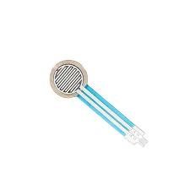
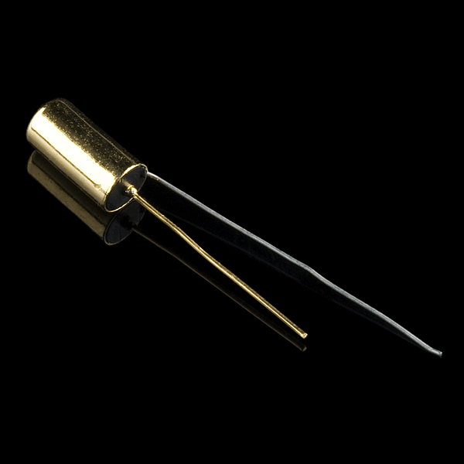
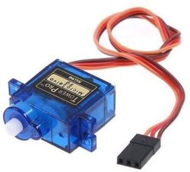
Gang members
01
02
03
Force sensor
Tilt/Flex sensor
Servo motor
A device whose resistance changes based on the force applied.
A tilt sensor measures the inclination or orientation.
A motor that allows you to control its precise angle or position.

Slide 5
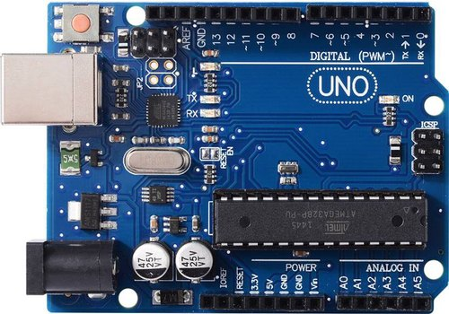
Microcontroller
We need to interface all our sensors and actuators with a microcontroller, so that the values can be controlled as required.
Find out how to do this in detail at:https://www.arduino.cc/en/Tutorial/Foundations

Slide 6
Putting it all together
1
2
Our first input is from the force sensor. Read that input.
The output is reflected in the speed of the servo motor. Set the speed accordingly by coding that on the microcontroller.
Then we have our tilt sensor / flex sensor. Read the input and display it using any means: serial monitor, LCD etc.
All the reading and writing will happen using the microcontroller.

Slide 7
Arduino Code
setServo
analogRead
Function used to set the speed of the servo motor
To display the tilt, use Serial.print() function or add an LCD.
Function used to read the input from force sensor and tilt sensor.

Slide 8
THANK YOU!
Any questions?
-IEEE UVCE PES

